Slide 1
Windows Structure

Slide 2
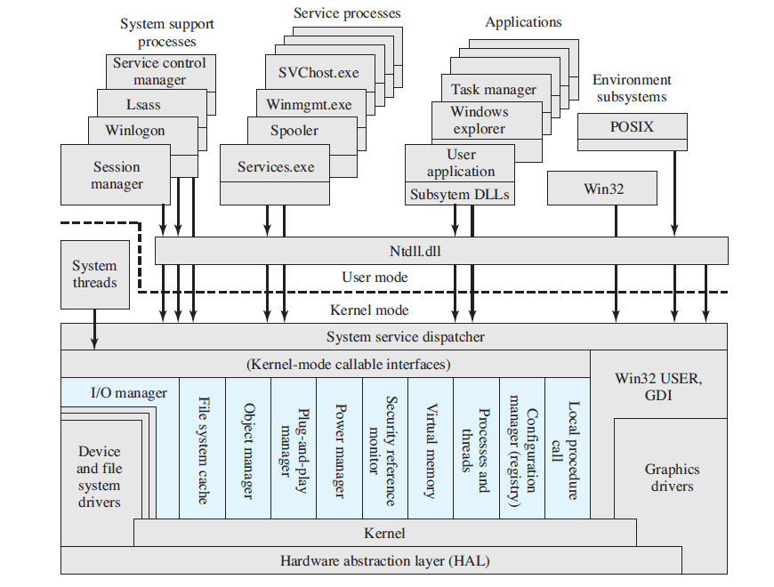
Windows & Vista Architecture (see Stallings Ed.6, p.83)
(coloured area is the Executive)

